Slide 1


Slide 2


Slide 3
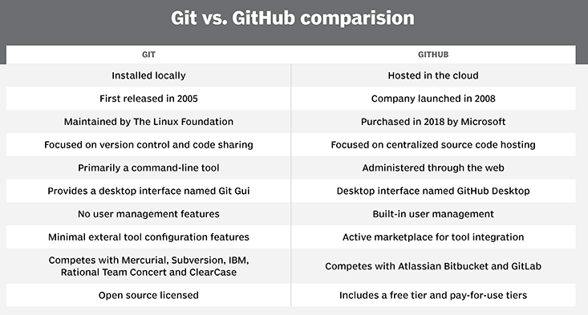

Slide 4
Why git
Version control system(vcs)
Alle utviklere har tilgang til all kode
Track history
Non-Linear
Open Source
Scaleable

Slide 5
How does the bloody thing work

Slide 6
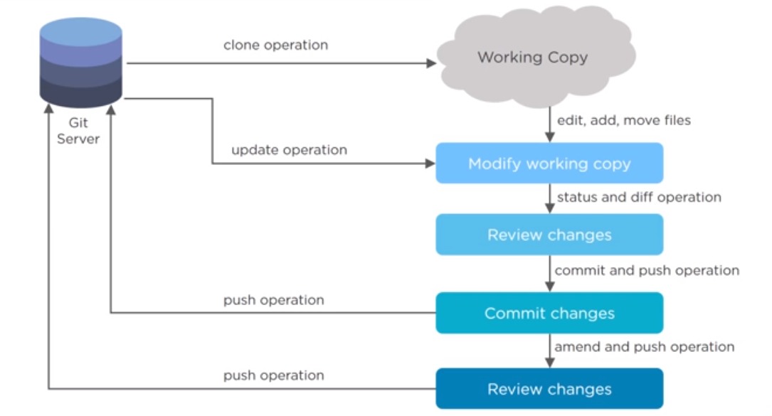

Slide 7
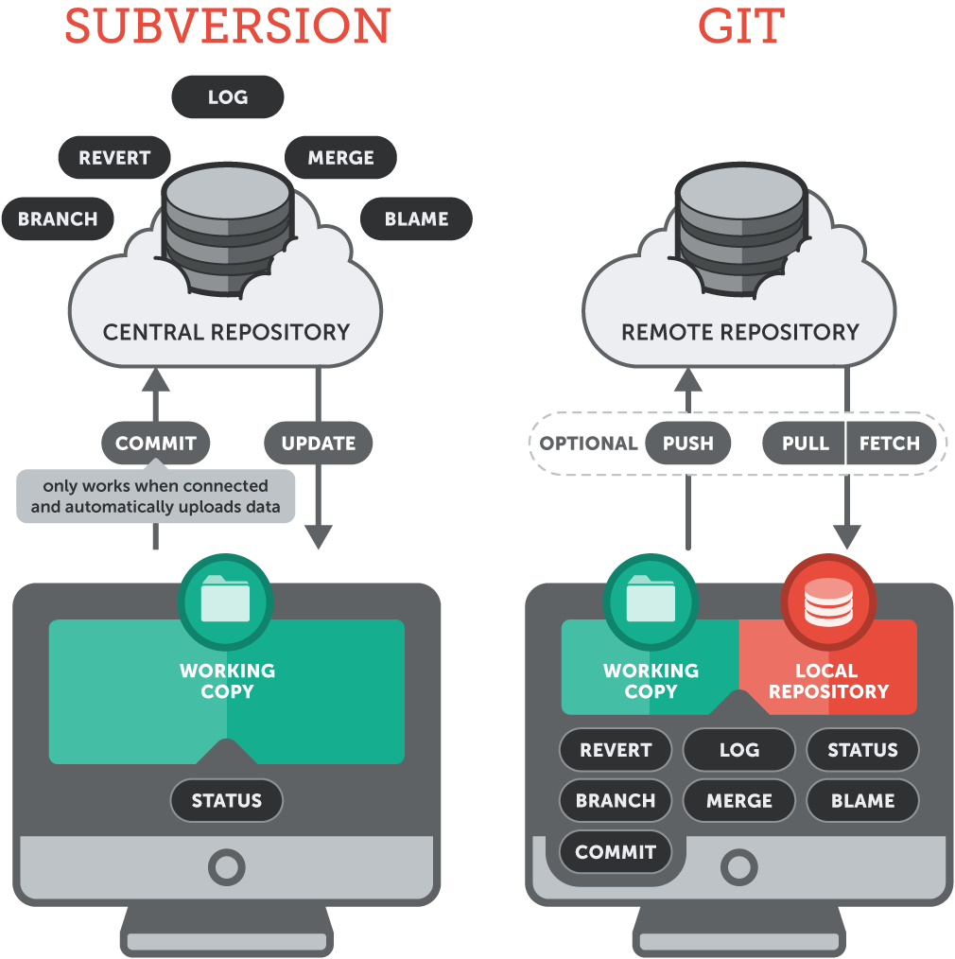

Slide 8
Connect git client to github
git config --global user.name "<YourUsername>"
git config --global user.email <YourEmail>
ssh-keygen -t rsa -b 4096 -C " <YourEmail>"
eval "$(ssh-agent -s)"
ssh-add ~/.ssh/id_rsa
vim ~/.ssh/id_rsa.pub
*copy key and add on git(settings ->SSH keys->add SSH)*
git clone git@github.com:<YourRepo>.git

Slide 9
Usefull commands
git --version
git status
git diff
git help
git clone git@github.com:<YourRepo>.git
git pull
git add --all
git commit --all -m "update"
git push
git branch universe1
git branch
git push origin universe1
git checkout master
git merge universe1
git brance -d universe1
git push origin :universe1

Slide 10


Slide 11
Web gui (demo)
url
TechTorsdag repo
Edit fils
Change log
Issue
Project
Network

Slide 12
Desktop app (demo)
Connect to user
Connect to repo
Hidden dir
Edit files
Make branch
Merge
Delete branch

Slide 13
VS Code plugin (demo)
Change file
Commit and push
Branch

Slide 14
Comand line (demo)
Add user to account
Clone repo
Change files

Slide 15
Use case
TC19

Slide 16
Ressurser
https://medium.com/datadriveninvestor/why-git-f0a607f61a77
https://medium.com/edureka/git-vs-github-67c511d09d3e
https://www.youtube.com/watch?v=s8DCpG1PeaU
https://lab.github.com/
https://git-scm.com/book/en/v2/Git-on-the-Server-The-Protocols
https://www.atlassian.com/git/tutorials/what-is-git
https://www.youtube.com/watch?v=LV-KRIS1AjQ
https://www.upguard.com/blog/microsoft-visual-studio-team-services-vs-github

Slide 17
Kule Repos
https://github.com/CiscoDevNet
https://github.com/ansible/ansible
https://github.com/Exa-Networks/exabgp/
https://github.com/docker
https://github.com/microsoft
https://github.com/DataKnox/
https://github.com/hpreston

